Slide 1
Come Fly With Me
An insight into aviation traffic within Australia

Slide 3
Data Source

Slide 4
Aviation statistics are published by the Bureau of Infrastructure, Transport, and Regional Economics (BITRE)
International & domestic activity are both available

Slide 5
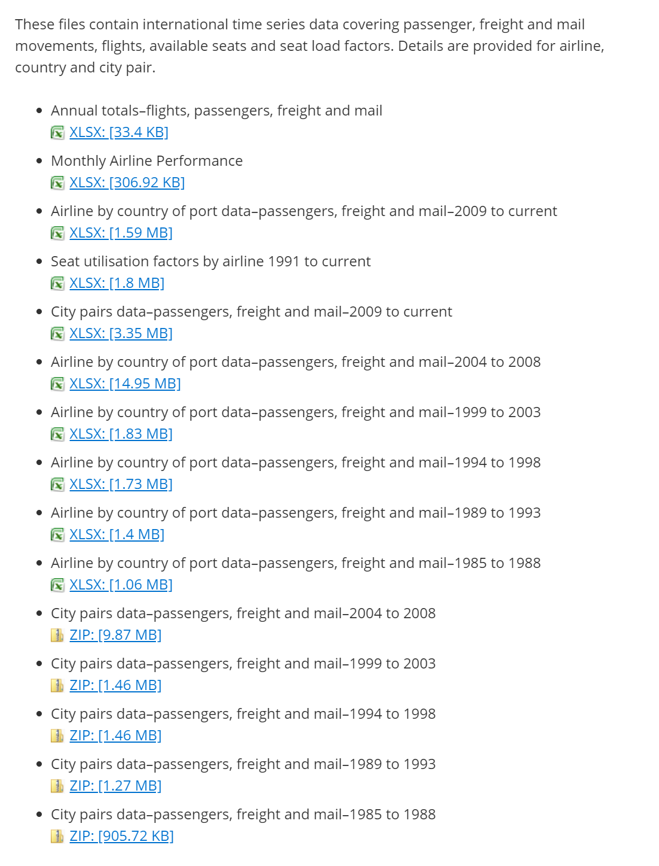
International
City pairs datasets are the most interesting

Slide 6
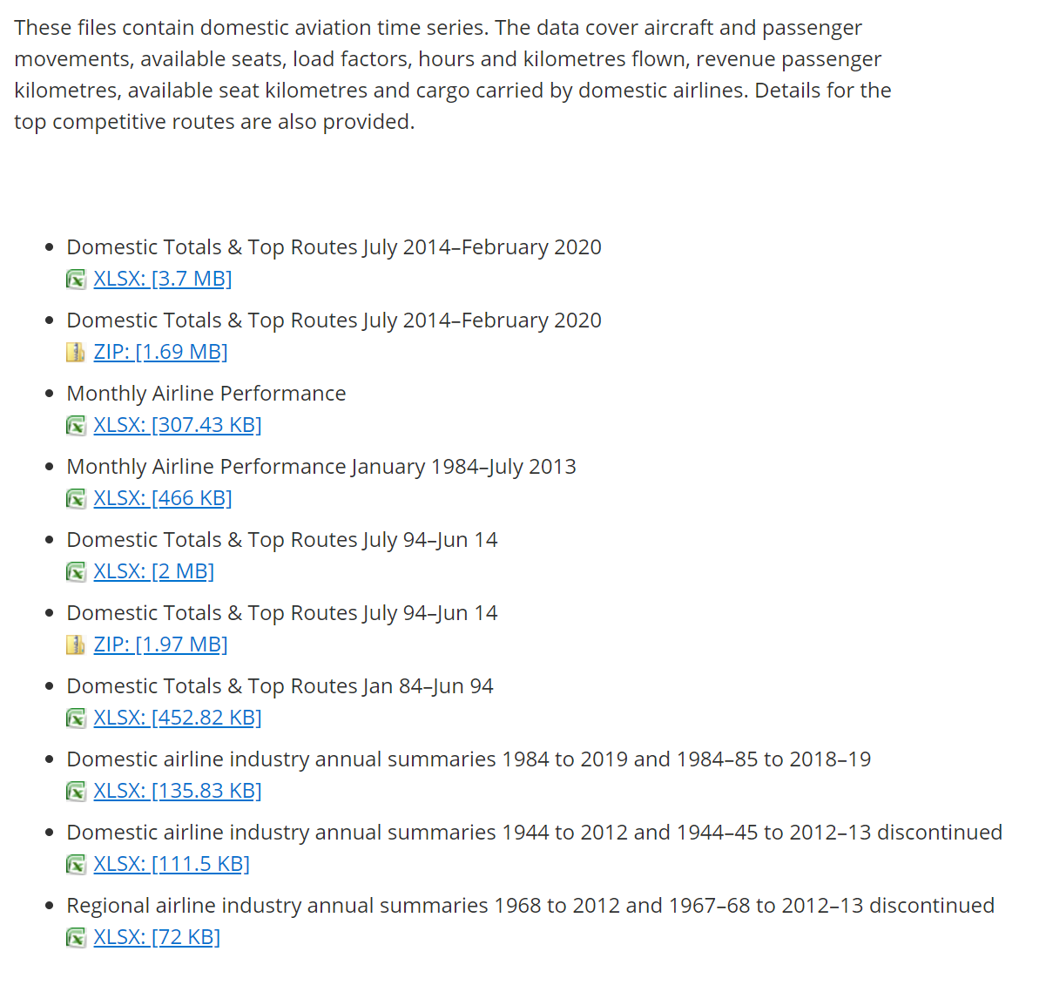
Domestic
Domestic Top Routes is similar to the International City Pairs data

Slide 7
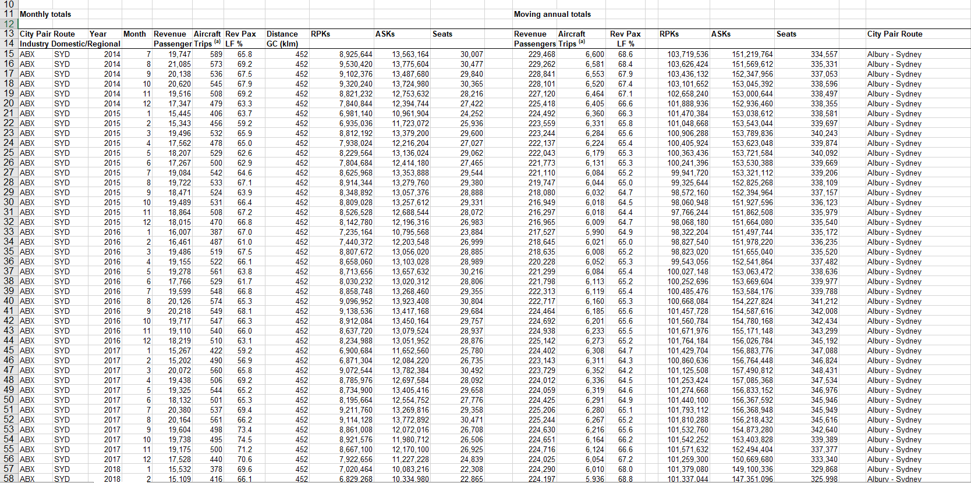

Slide 8
Processing

Slide 9

pandas used to combine excel spreadsheets into a data frame
Remove unnecessary columns while importing

Slide 10

xarray provides fantastic n-dimensional arrays
Pandas data is then converted to an xarray structure – simplifying working with multidimensional data

Slide 11
Initial Visualizations

Slide 12
Initial Visualizations
Important part for initial visualizations is to see overall Australian trends at a glance

Slide 13
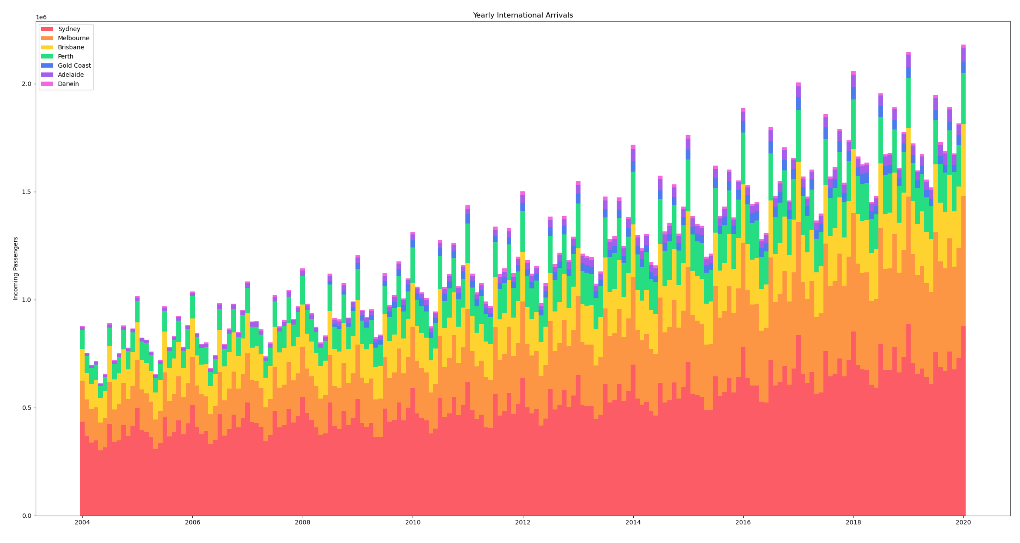
Yearly Arrivals
Stacked bar chart showing total arrivals in Australia each month
Arrivals are trending upward as times goes on
Volume oscillates on a seasonal basis

Slide 15
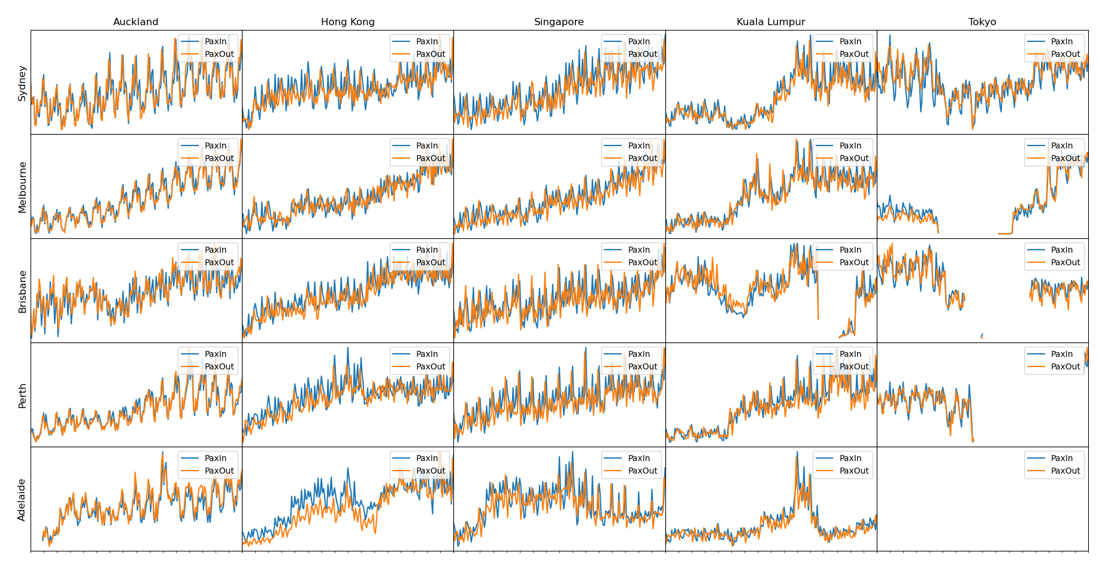
Trends
Trend graphs between various locations in Australia and international hotspots
Axes between charts are not to scale – trends only!
Similar upwards trend is visible
Seasonal fluctuations are more pronounced

